Slide 1
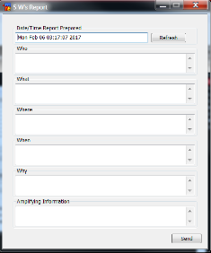
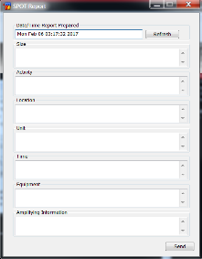
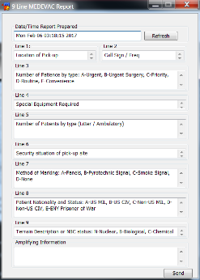
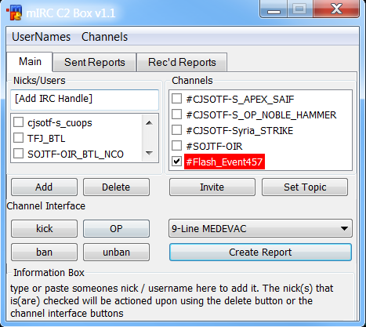
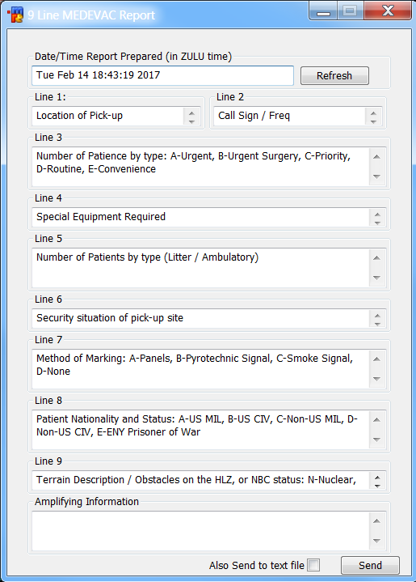
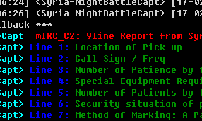
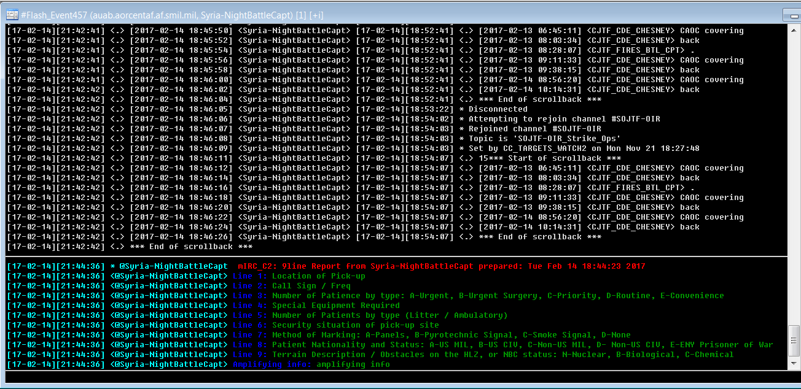
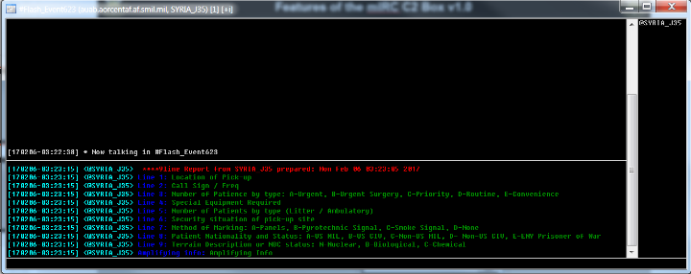
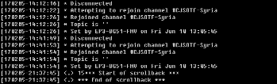
The mIRC C2 Box v1.1
The standard 5 W’s Report
Summary: The mIRC C2 Box v1.1 is a mIRC interface which allows the user to publish standard reports to several mIRC channels and users simultaneously and in a distinct color pattern to characterize it from the regular channel chatter. These reports can automatically be sent to a file and attached to emails for further distribution and knowledge management.
Additionally, the interface can alert the user when certain reports are generated in any channel in which they participate.
The standard SPOT Report
The 9-Line MEDEVAC Report
UNCLASSIFIED

Slide 2
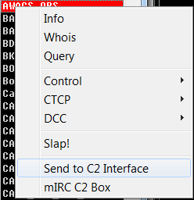

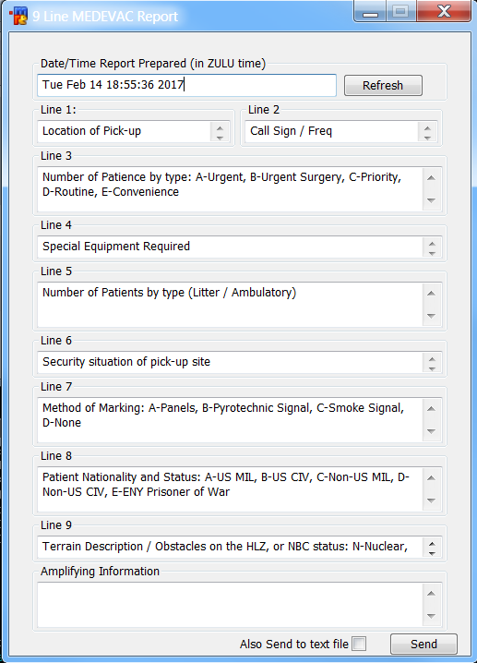
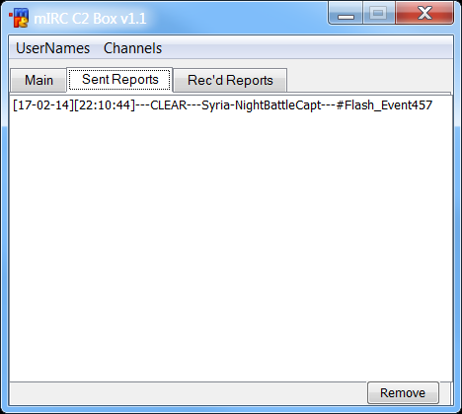
Features of the mIRC C2 Box v1.1
Type in users/nicks to add to your list
The channel box automatically updates with whatever channels you are in / open
Right click a user/nick in a channel to automatically add to your list
Set the topics in the rooms you control
Click the report drop-down to select a type of report
Reports are automatically generated with the date/time you opened it (this can be changed/refreshed)
Helpful information appears here as you roll over buttons
Click the “Create Report” button to open up the reports
The “Sent Reports” tab will keep track of when, where and by whom reports were sent
Additional report formats can be created and added to the mIRC C2 Box; Report formats can include helpful information about what needs to be written into each field.
Invite Only channels can be created on the fly to deal with flash events and critical situations
Reports will be sent to the nicks / channels selected when you click “Send”
(Future updates will include the ability to access stored versions of reports and automatically collect reports sent by other users in the channels)
This will send the report to a WORD document and open it up
(Future updates will include the option to attach it to an email automatically)
UNCLASSIFIED

